Slide 1
Control Engineering
Lecture 5

Slide 2
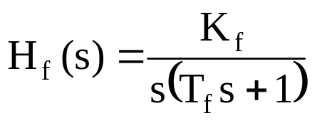
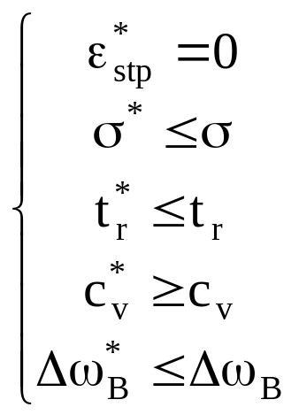
Frequency design methods
For process transfer function
and an imposed performance set:

Slide 3

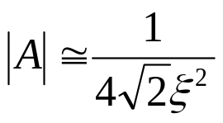
Frequency design methods
Design of a P controller
M^{dB}
-20
c_{v}
ω_{t}
ω_{f}
|A|
1
10
N
ω
F
-40
|H_{d}|
|H_{f}|

Slide 4
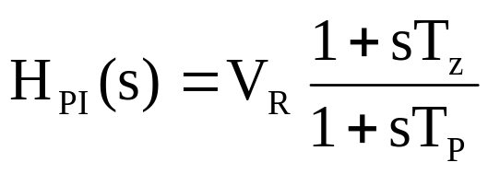
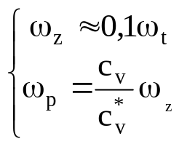
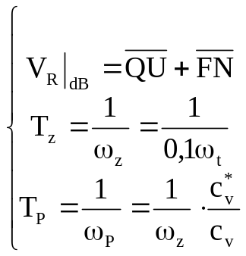
Frequency design methods
Design of a PI controller
M^{dB}
-20
|H_{dC}|
U
Q
-40
c_{v}
ω_{t}
-20
ω_{f}
|A|
1
ω_{p}
ω_{z}
10
N
ω
F
-40
|H_{f}|
|H_{d}|

Slide 5
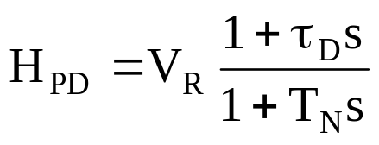
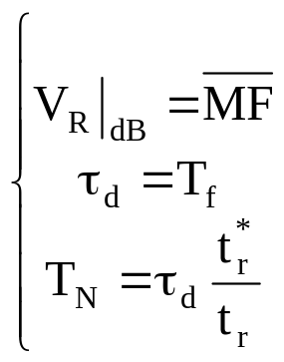
Frequency design methods
Design of a PD controller
M^{dB}
-20
c_{v}
ω_{t1}
ω_{t2}
|A|
1
10
M
ω
N
F
-40
|H_{d2}|
|H_{d1}|
|H_{f}|

Slide 6
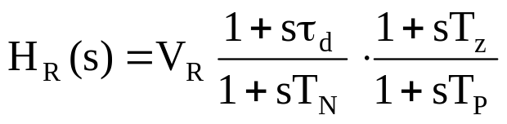
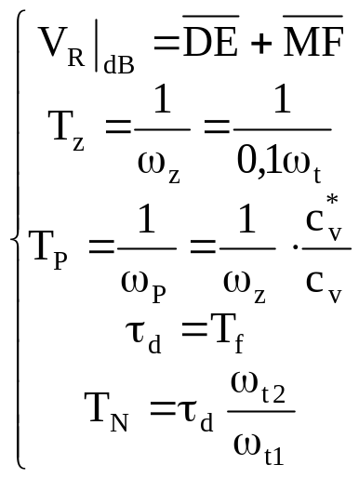
Frequency design methods
Design of a PID controller
M^{dB}
-20
|H_{d2}|
D
E
-40
c_{v}
ω_{t}
-20
ω_{f}
1
ω_{p}
ω_{z}
10
M
ω
|A|
N
F
-40
|H_{dC}|
|H_{f}|
|H_{d1}|

Slide 7
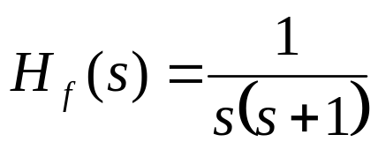
Example
Design a controller for the DC motor with the transfer function
to obtain a steady-state error of less than 0.1 for a unit-ramp input and an overshoot Mp < 25%.

Slide 8
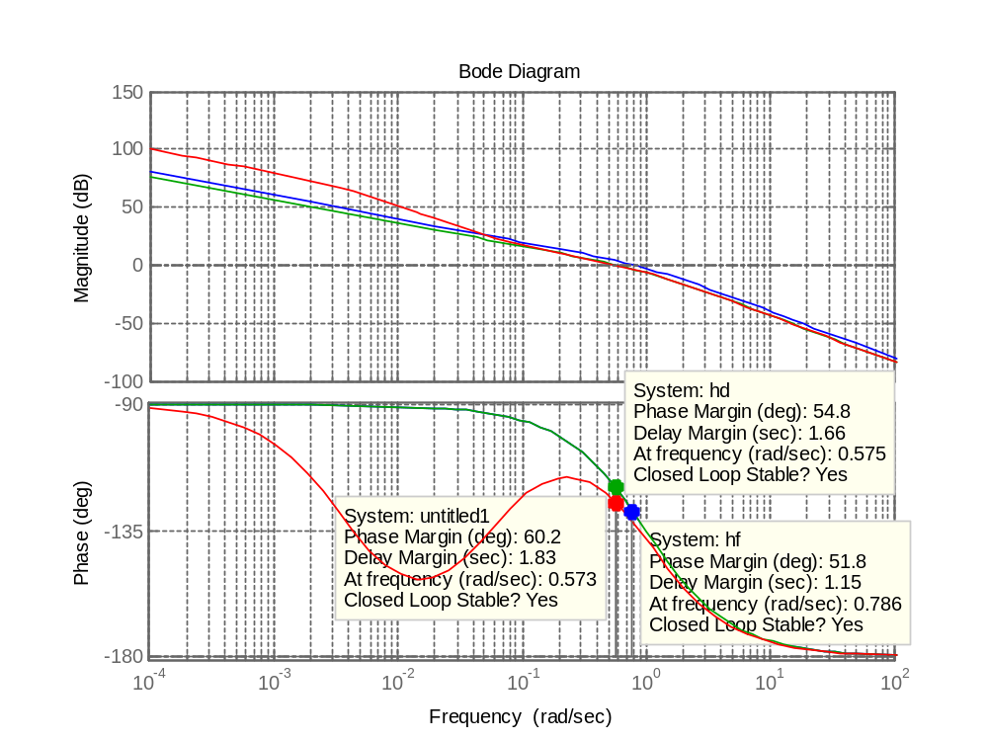
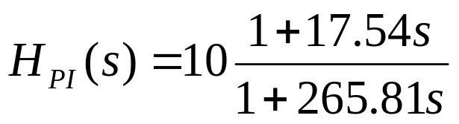
Example

Slide 9
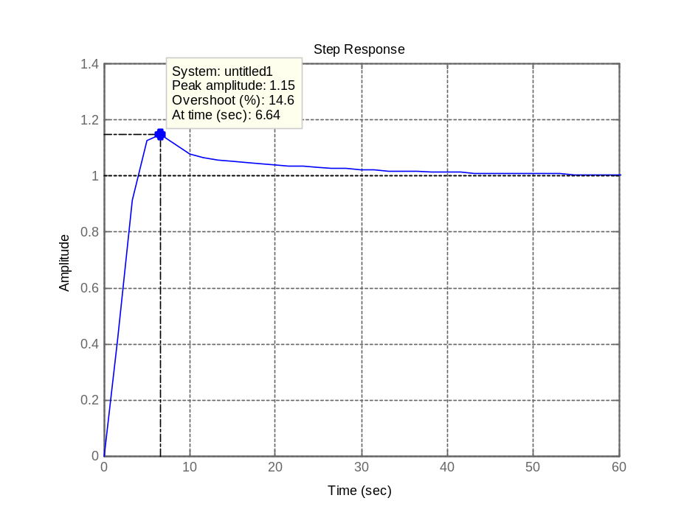
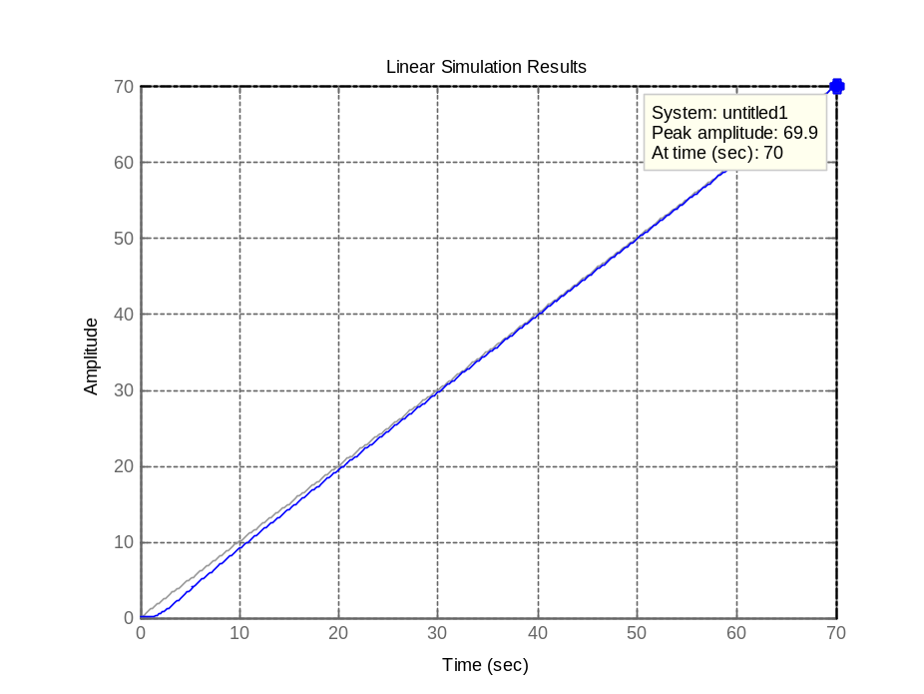
Example

